Slide 1


Slide 2

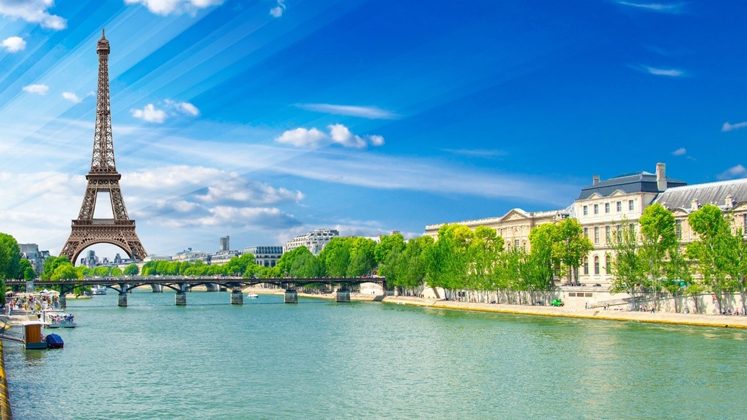
Content
Our team
What is our project about
Which programming language we used
Why we chose this topic
What is the purpose of our project

Slide 3
Our team
Plamen Kostov – PKKostov18@codingburgas.bg
Ilian Yanev – IMYanev18@codingburgas.bg
Kristian Lalev – KALalev18@codingburgas.bg
Kiril Dimov – KHDimov18@codingburgas.bg
Hristo Hristov – HSHristov18@codingburgas.bg
Kristiyan Karchev – KKKarchev18@codingburgas.bg

Slide 4
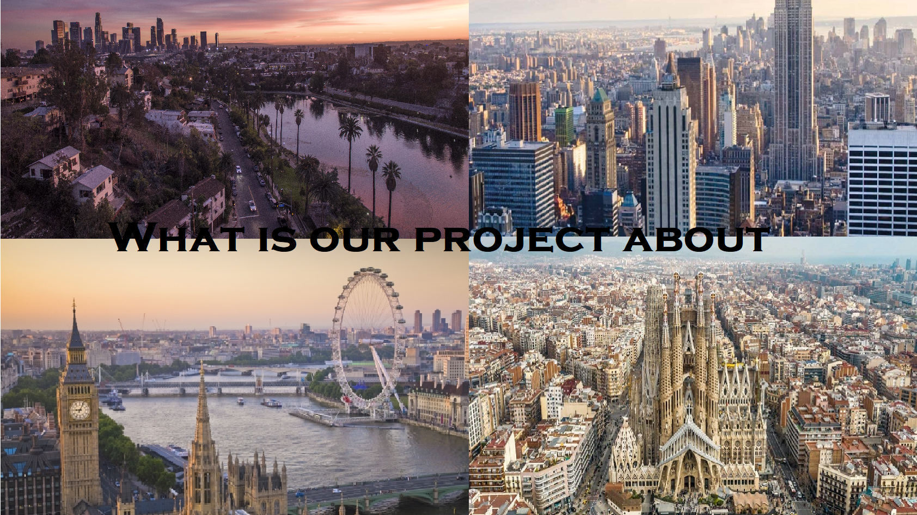

Slide 5
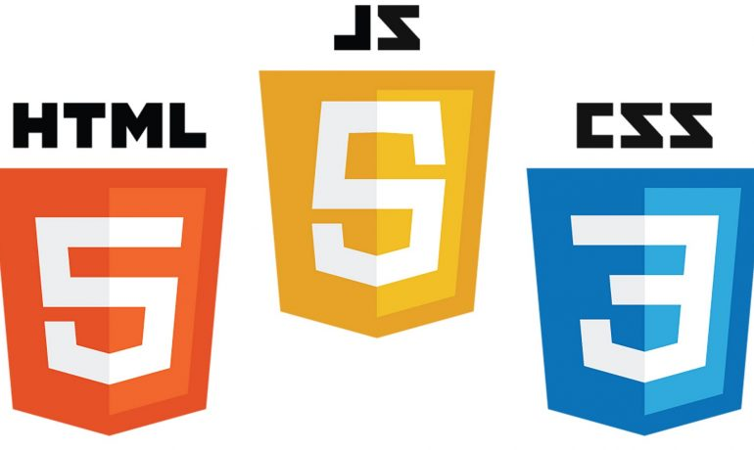
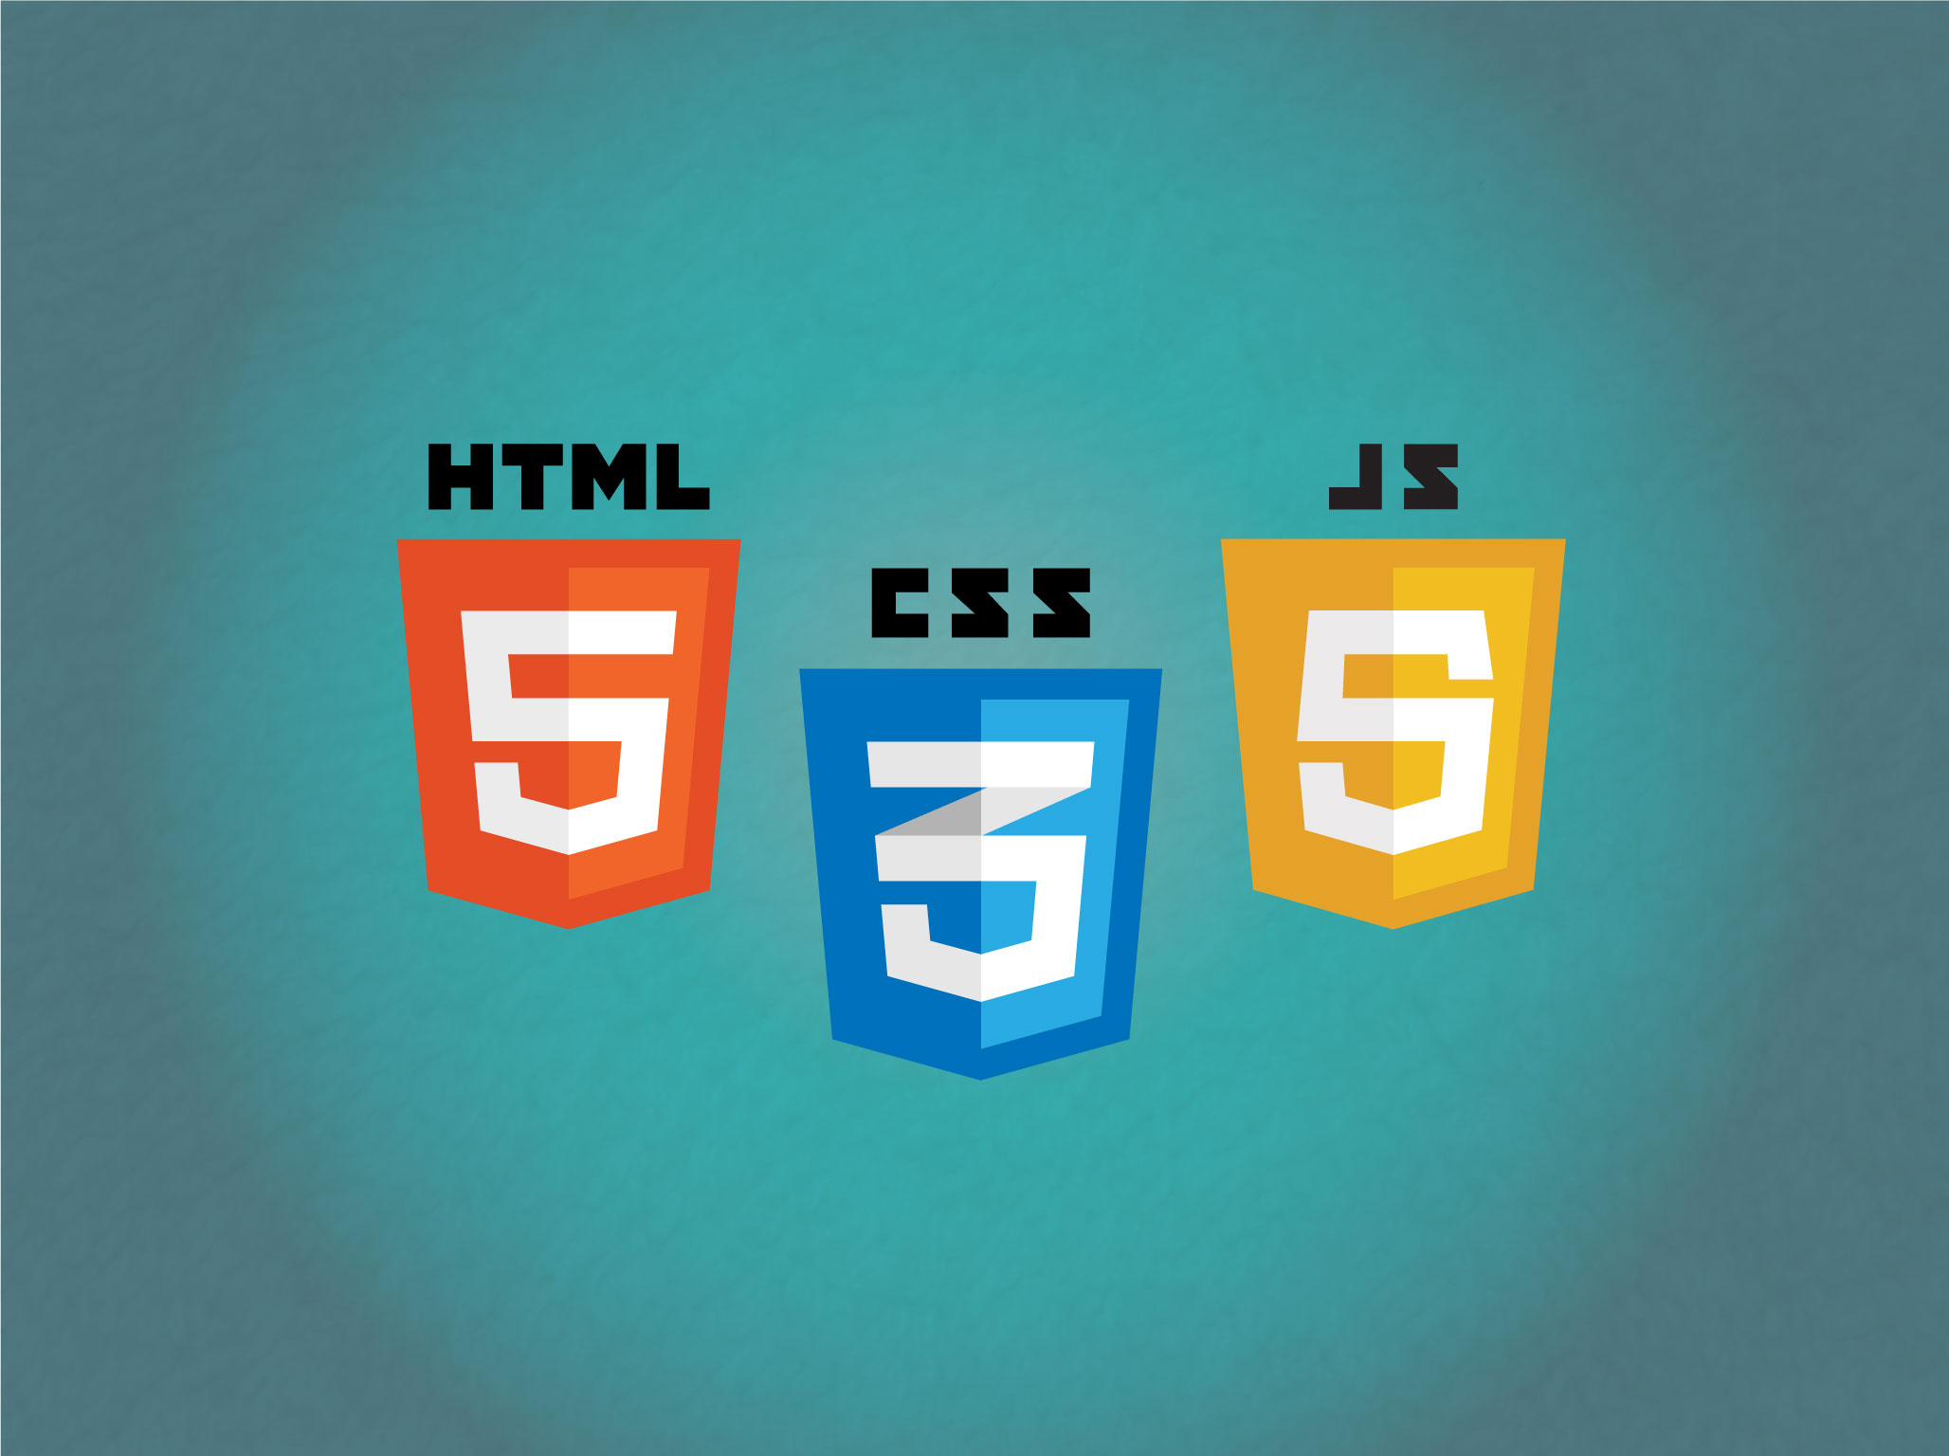
What languages we used so far?
Notes:
We used HTML 5 and CSS 3 and Javascript

Slide 6
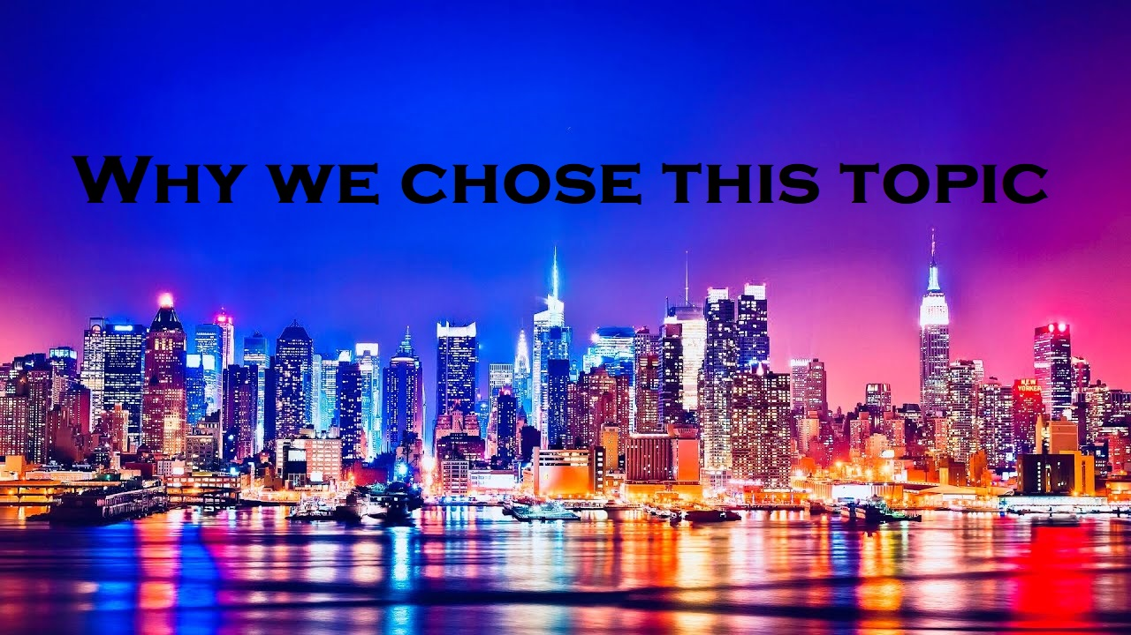

Slide 7

What is the purpose of our project?

Slide 8
Thank you for the attention!

